Slide 1


Santosh Kumar Kar,
skkar.2k2@gmail.com

Slide 2
CHAPTER – 1
Spring Boot

Slide 3
Before we start
A task for you – time 15 minutes
Develop a small application
Is a rest controller
Deployable in an app server such as Tomcat Server
Use Spring Rest Controller, Spring Data JPA, Hibernate
DB MySQL DB, has to read & write employee data from and to the DB
Either WAR or JAR which is deployable.
Your module is unit testble

Slide 4
Before we start
List out the challenges you have faced while setting up the env.
Download and set up an app server (e.g. Tomcat)
Download and install a DB
Get all required Spring jars, importantly they all should compatible with each other
Download the jars for Spring
Download Hibernate jar compatible with the Spring version
Download jar for MySQL driver
Setting up web.xml to use spring MVC
Anything I left ?????

Slide 5
Why Spring Boot
Provides a radically faster and widely accessible ‘getting started’ experience for all Spring development
No clumsy XML Configuration by developers
Provide opinionated ‘starter’ POMs to simplify your Maven configuration
Uses project management tool such as MAVEN or GRADLE
Helps fast development and production ready code
Embed Tomcat, Jetty or Undertow directly (no need to deploy WAR files)
In memory DB

Slide 6
Documentation
http://docs.spring.io/spring-boot/docs/current/reference/html/index.html

Slide 7
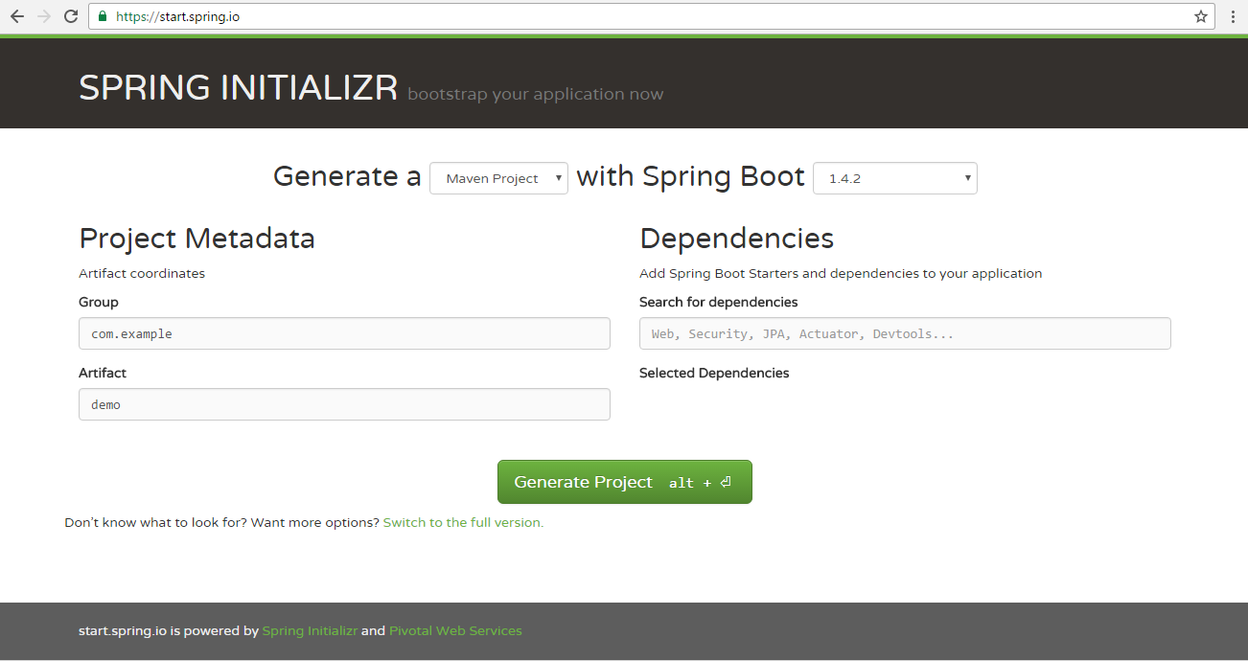
http://start.spring.io – a good starting point

Slide 8
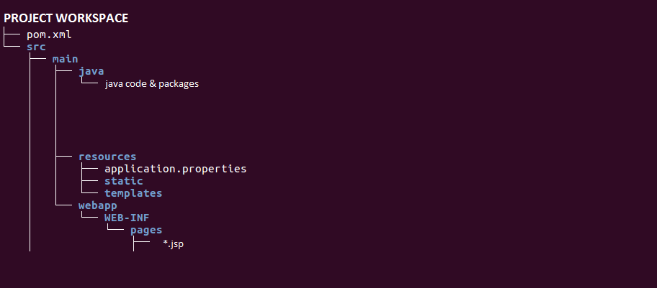
Folder Structure to be followed

Slide 9
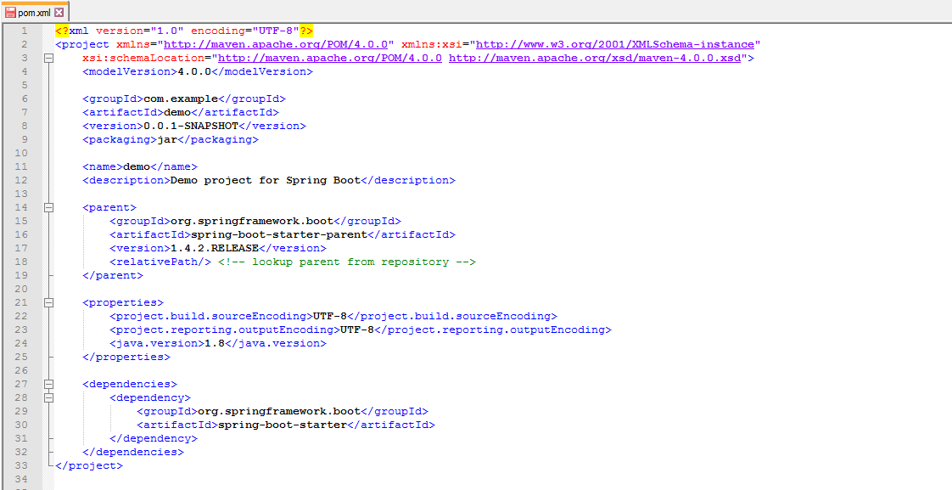
Understanding pom.xml

Slide 10
Spring-boot-starter-parent
The parent POM
Provides dependency and plugin management for Spring Boot-based applications
contains
the default versions of Java to use
default versions of dependencies that Spring Boot uses
the default configuration of the Maven plugins

Slide 11
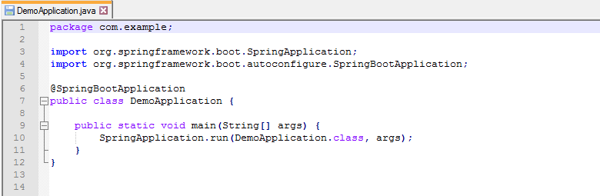
First Java Program for spring boot

Slide 12
Running the application
> mvn spring-boot:run

Slide 13
Spring-boot-starter Maven Templates
Templates that contain a collection of all the relevant transitive dependencies
Each start is for a particular functionality.
Each starter contains a group of dependencies of a particular function. Can check the POM.xml
https://github.com/spring-projects/spring-boot/tree/master/spring-boot-project/spring-boot-starters

Slide 14
@SpringBootApplication
Enables the three features:
@EnableAutoConfiguration Tells Spring Boot to "guess" how you will want to configure Spring, based on the jar dependencies that you have added. For example, If HSQLDB is on your classpath, and you have not manually configured any database connection beans, then Spring will auto-configure an in-memory database.
@ComponentScan
@SpringBootConfiguration

Slide 15
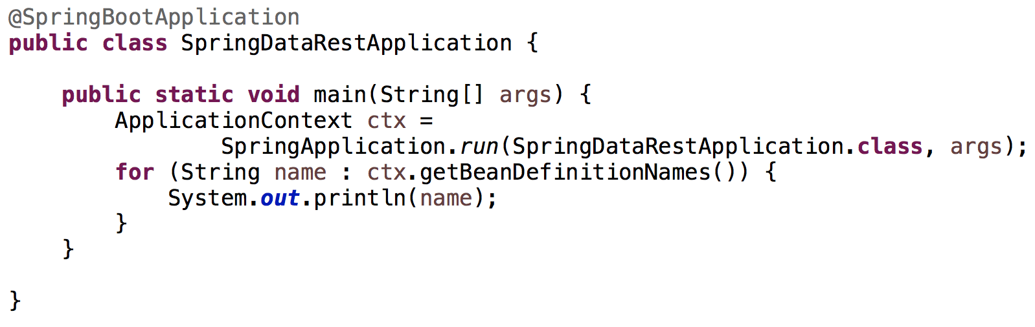
Beans by Spring Boot

Slide 16
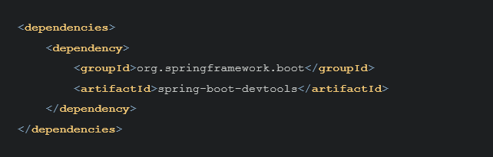
Devtools
Automatic Restart
LiveReload
Remote Debug Tunneling
Remote Update and Restart
Details at:
http://docs.spring.io/spring-boot/docs/current/reference/html/using-boot-devtools.html

Slide 17

Spring Tool Suite (sts)
Download https://spring.io/tools/sts/all

Slide 18
starter-web

Slide 19
Rest Controller
@RestController
@Mapping
@GetMapping
@PostMapping
@PutMapping
@DeleteMapping

Slide 20
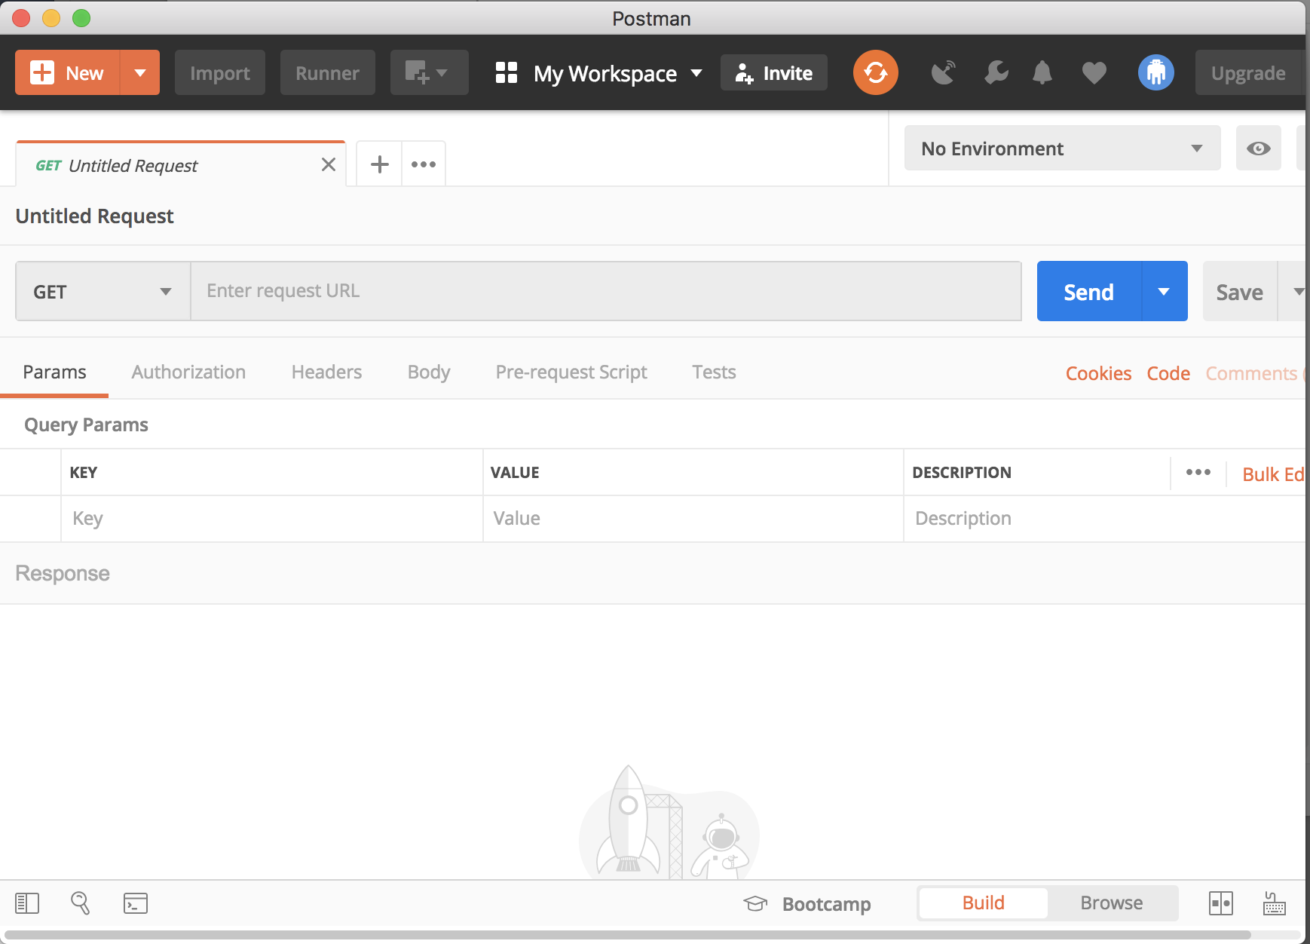
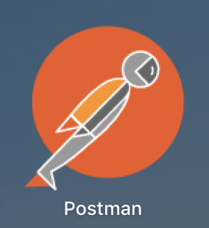
Rest Client (Postman)

Slide 21
starter-jdbc

Slide 22
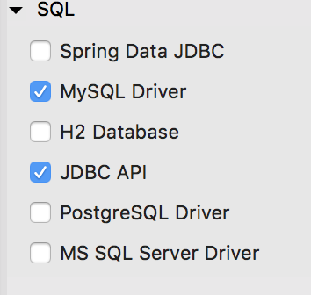
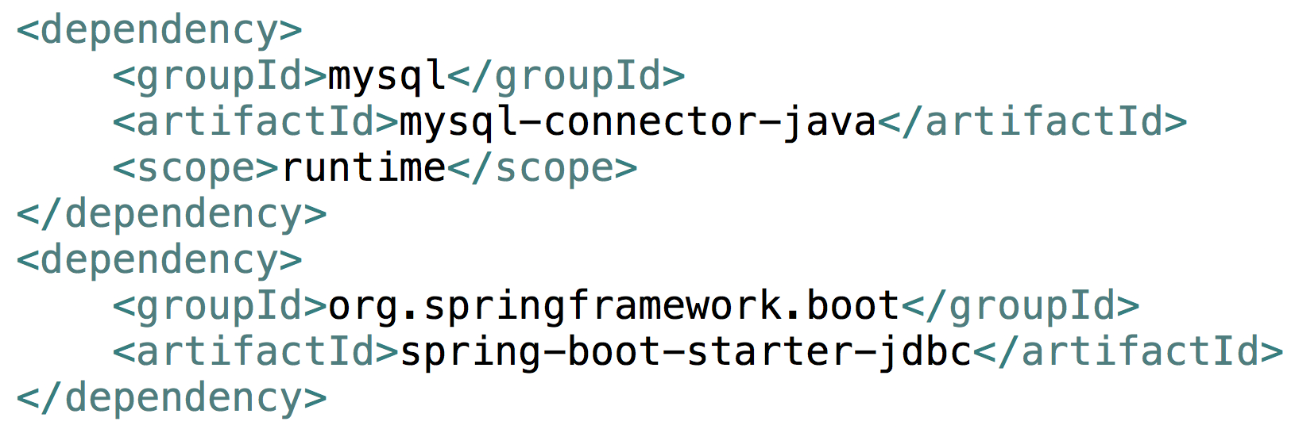
JDBC API
Now can @Autowire jdbcTemplate

Slide 23
starter-data-jpa

Slide 24
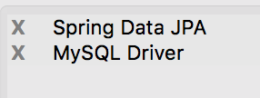
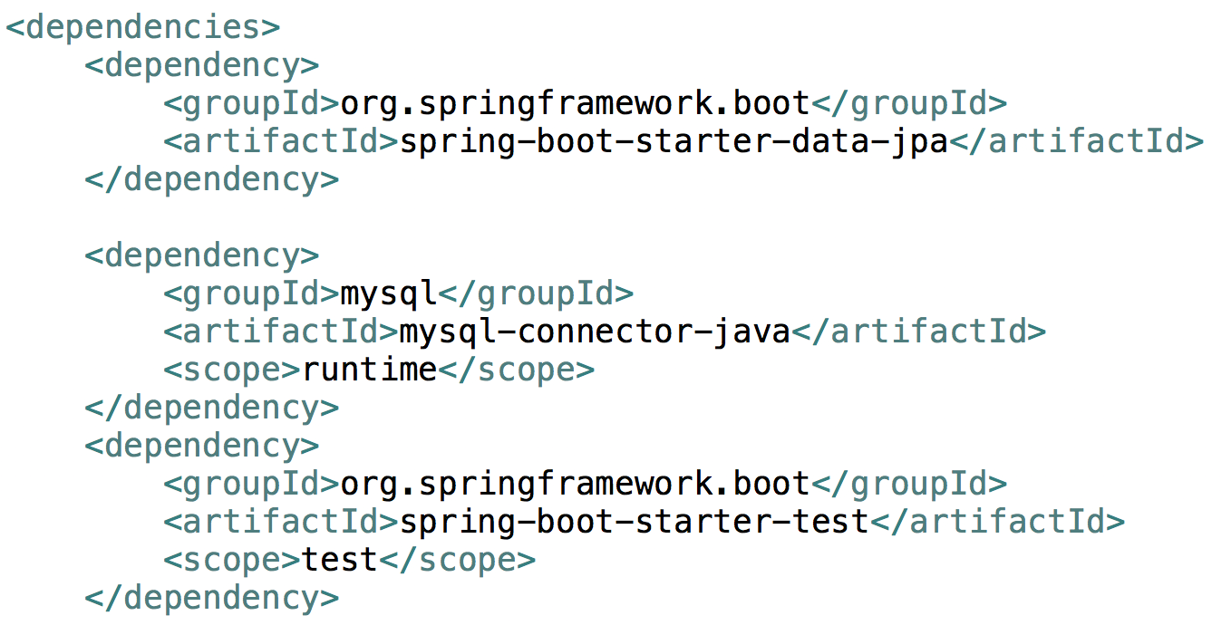
Spring Data JPA

Slide 25
HATEOAS

Slide 26
HATEOAS Hypermedia As The Engine Of Application State
Hypermedia As The Engine Of Application State

Slide 27
The term “hypermedia” refers to any content that contains links to other forms of media such as images, movies, and text.
This architectural style lets you use hypermedia links in the response contents so that the client can dynamically navigate to the appropriate resource by traversing the hypermedia links

Slide 28
Advantages of HATEOAS
Required APIs could be easily found without any specific documentation
Make the response navigable with links to common resource URIs
Get the message URL of the response itself
If any URL changes from the server-side, there's no need to do any change on the client-side
If we follow proper HATEOAS, the client actually doesn't need to spend much time understanding API documentation. As an end-user, we don't have to go through documentation every time we visit a new website. We just go to the homepage and go through the links. With HATEOAS, the web service is super helpful to the clients.

Slide 29
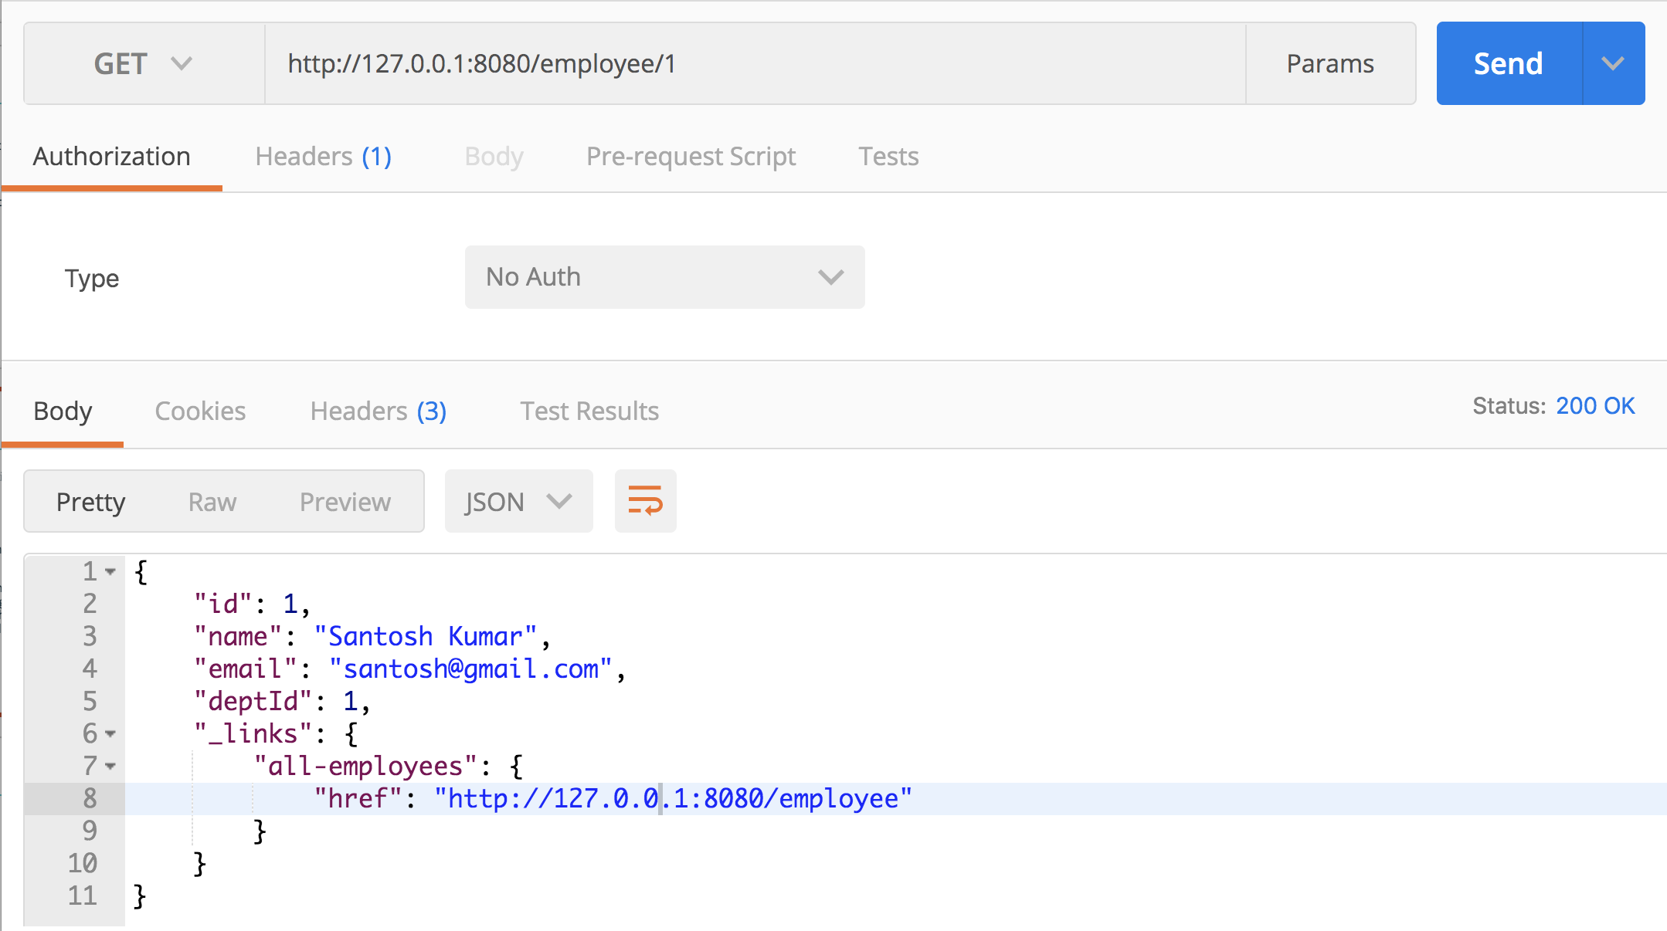
Hateoas

Slide 30
JPA Data With Rest

Slide 31
Spring Data REST
Spring Data REST takes the features of
Spring HATEOAS and
Spring Data JPA
and automatically combines them together

Slide 32
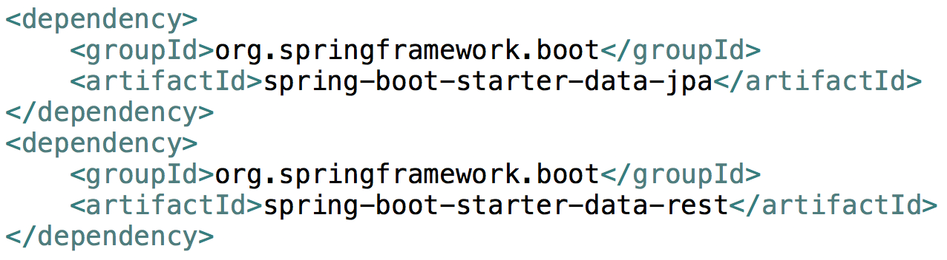
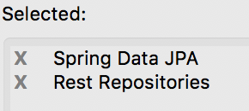
Spring Data Rest + JPA
Things to do
Add Driver dependency
Write the required repositories
Access the URL

Slide 33
In-memory database in Spring Boot

Slide 34
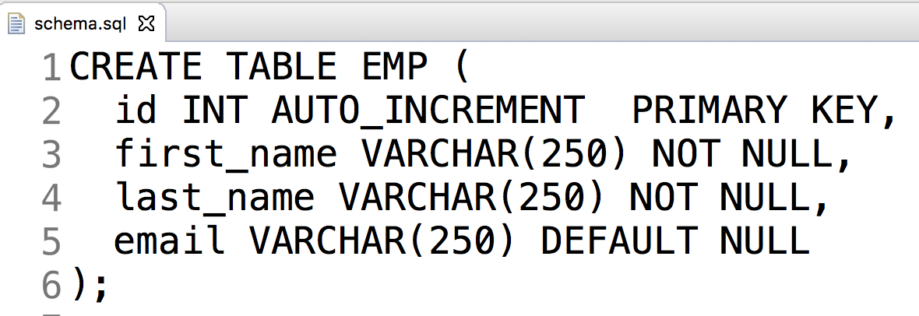
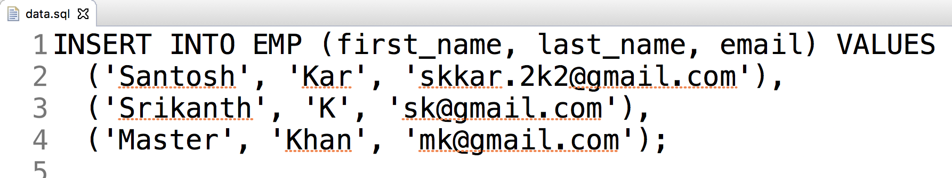
Auto execute sql scripts:
2 SQL files in src/main/resources
schema.sql
data.sql

Slide 35
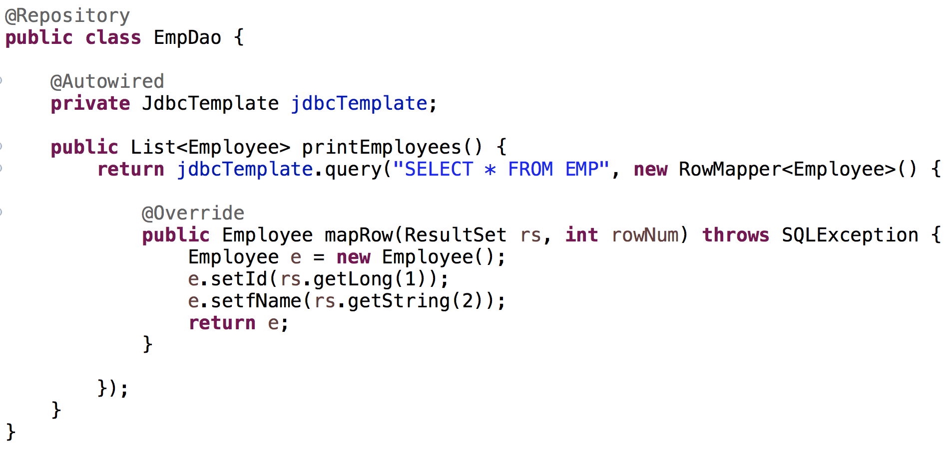
Dao with H2 DB

Slide 36
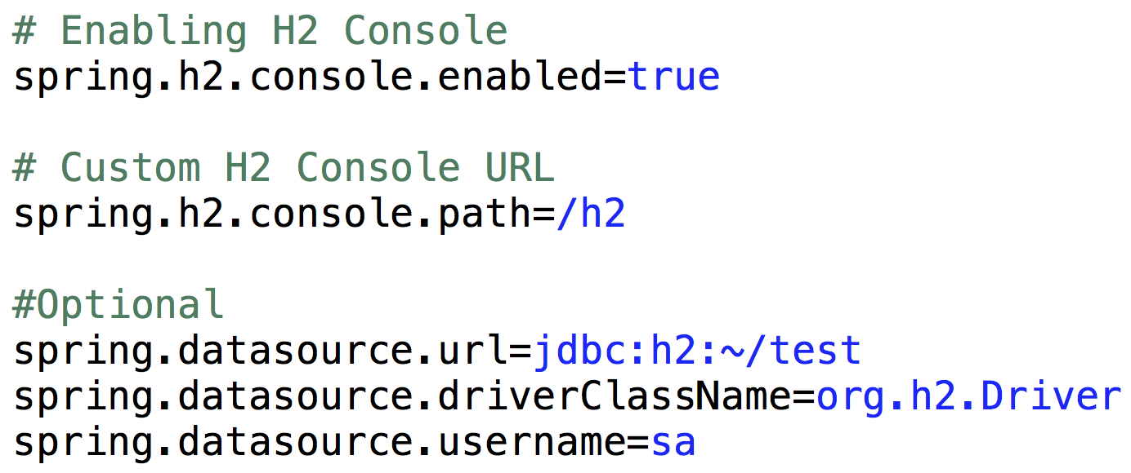
Optional – to access H2 Console

Slide 37
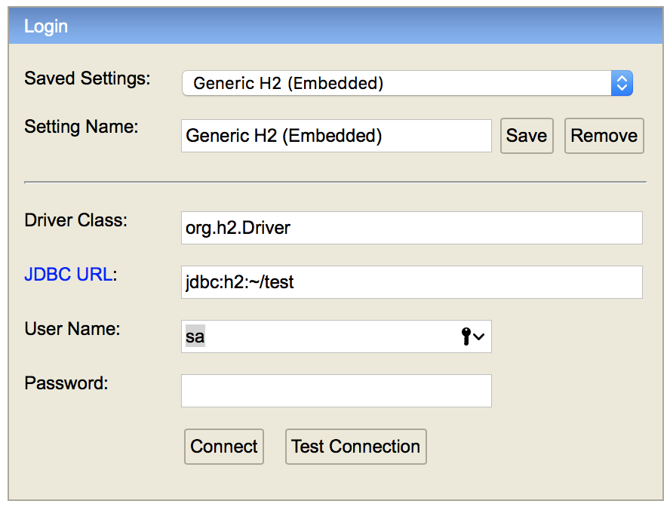
Access H2 Console http://localhost:8080/h2

Slide 38
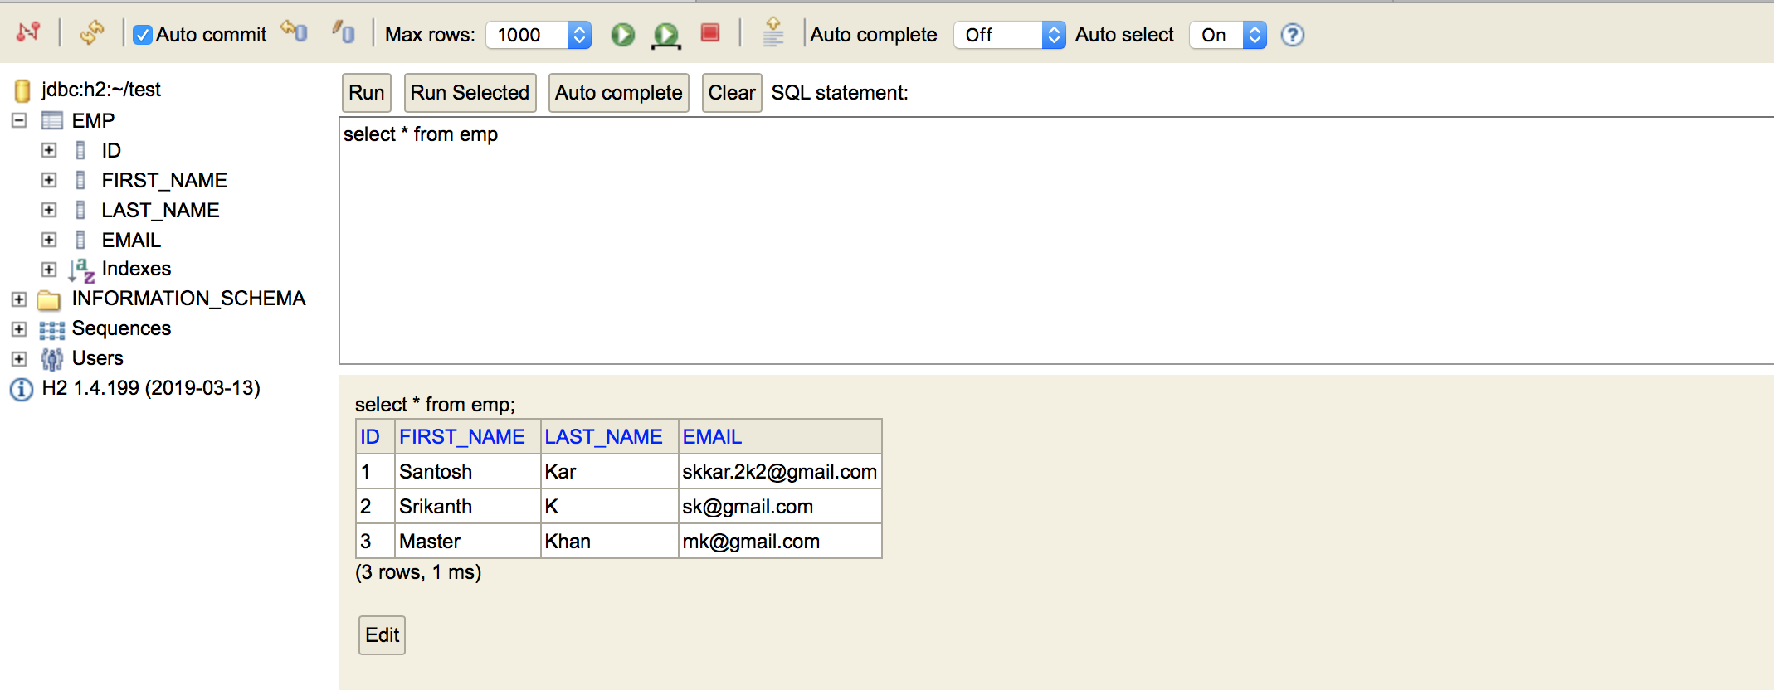
After login in H2 Console

Slide 39
Spring Web (MVC)

Slide 40
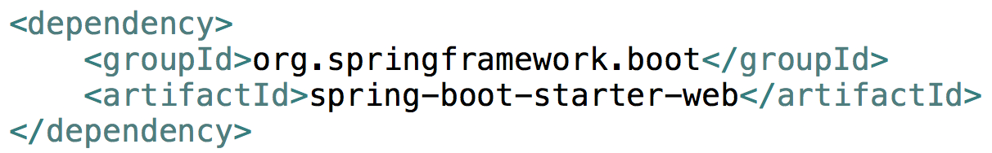

To enable support for JSP’s, add tomcat-embed-jasper dependency manually
<dependency>
<groupId>org.apache.tomcat.embed</groupId>
<artifactId>tomcat-embed-jasper</artifactId>
</dependency>
To enable JSTL, add jstl dependency manually
<dependency>
<groupId>javax.servlet</groupId>
<artifactId>jstl</artifactId>
</dependency>

Slide 41
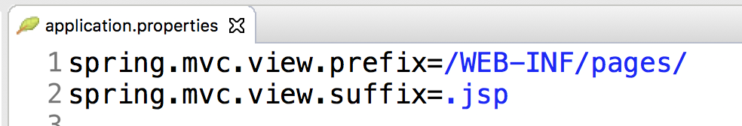
In application.properties
Configure the Spring MVC

Slide 42
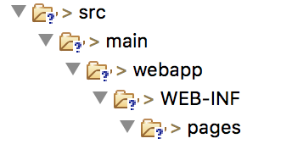
Directory path to store JSP
Create the directory path (as mentioned) to store the jsp pages that matches the application.properties cofiguration.
In src/main
src/main/webapp/WEB-INF/pages
Place all your .jsp files here in the pages
*.jsp

Slide 43
Unit Testing the application
Please refer the project: RestfulControllerWithRepo

Slide 44
Exception Handling
@ResponseStatus(HttpStatus.NOT_FOUND)
public class EmployeeNotFoundException extends Exception {
private static final long serialVersionUID = -6794664688183647302L;
public EmployeeNotFoundException() {
super();
}
public EmployeeNotFoundException(String message) {
super(message);
}
public EmployeeNotFoundException(String message, Throwable cause) {
super(message, cause);
}
public EmployeeNotFoundException(Throwable cause) {
super(cause);
}
}

Slide 45
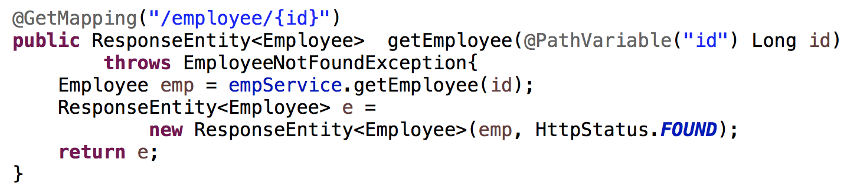
Exception Handling

Slide 46
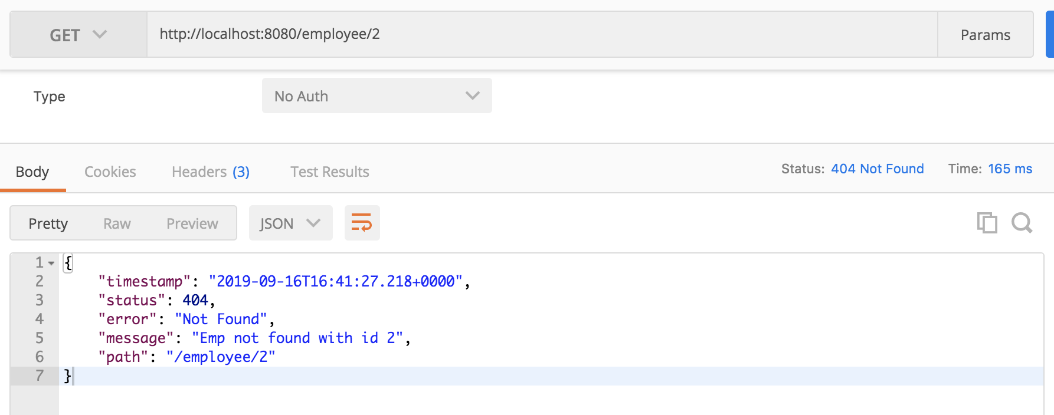
Exception Handling

Slide 47
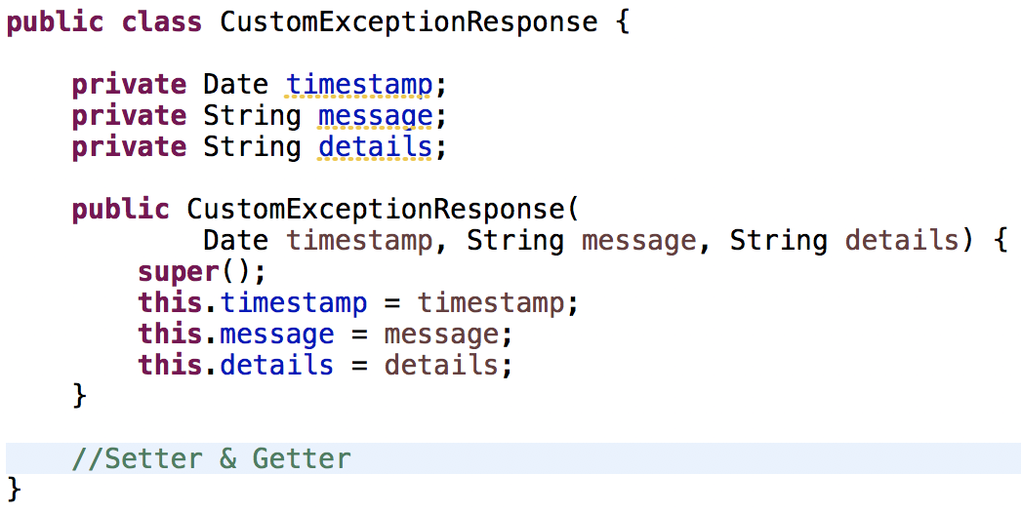
Customizing Exception Response
1. Customize the Response

Slide 48
Customizing Exception Response
2. Write Custom Exception Handler
@ControllerAdvice
@RestController
public class CustomExceptionHandler
extends ResponseEntityExceptionHandler{
// Implement Custom Exception Handlers here
}

Slide 49
Customizing Exception Response
Write Custom Exception Handler
For any specific Exception
/*
EmployeeNotFoundException
*/
@ExceptionHandler(EmployeeNotFoundException.class)
public final ResponseEntity<CustomExceptionResponse> handleUserNotFoundException(Exception ex, WebRequest request) {
CustomExceptionResponse response =
new CustomExceptionResponse(
new Date(), ex.getMessage(), request.getDescription(false));
return new ResponseEntity<CustomExceptionResponse>(
response, HttpStatus.NOT_FOUND);
}

Slide 50
Customizing Exception Response
Write Custom Exception Handler
For any specific Exception
/*
Generic Exception
*/
@ExceptionHandler(Exception.class)
public final ResponseEntity<CustomExceptionResponse> handleAnyException(Exception ex, WebRequest request) {
CustomExceptionResponse response =
new CustomExceptionResponse(
new Date(), ex.getMessage(), request.getDescription(false));
return new ResponseEntity<CustomExceptionResponse>(
response, HttpStatus.INTERNAL_SERVER_ERROR);
}

Slide 51

Questions
Send to skkar.2k2@gmail.com

